Slide 1

Skilled Emigration of Caribbean Nationals to the United States
Presenter: Marcy Jagdeo
PhD Candidate, Economics
Howard University

Slide 2
Research Question ?
Has the pattern of skilled migration to Caribbean nationals to the United States changed since the removal of work-permit restriction among Caribbean member states ?

Slide 3
Context
This study will look specifically at countries which are members of CARICOM
What is CARICOM?
Caribbean Community (CARICOM) is aimed a promoting economic integration between its 15 member sates
What is CSME?
The CARICOM Single Market and Economy (CSME) is an enlarged market which aims to provide a foundation for growth and development through the creation of a single economic space for the production of competitive goods and services.
In this single market space, there is free movement of skilled labor for certain occupational categories removing work permit restrictions

Slide 4
Why is this Question Important?
Migration affects both sending and receiving countries
Many countries in the Caribbean have lost more than 70 percent of their labor force , which is amongst the highest rates of brain drain in the world (Mishra, 2006)
CSME was implemented to provide full employment of labor and to curb the loss of its skilled labor force

Slide 5
Findings from Previous Studies
Thirteen (13) Caribbean countries were ranked among the 20 countries with the highest skilled migration rates and seven occupy the first positions with Guyana, Grenada, Jamaica, St. Vincent and Haiti (Castellani, 2007)
While all socioeconomic groups in the Caribbean participate in the exodus, Caribbean migrants comprise of a select population. Caribbean migrants strongly over-represent young adults from the age s of 20 and 39 with women more than men choosing to migrate. (Thomas-Hope, 2002)
On average, Caribbean migrants had better-paying and more skilled occupations than non-migrants in their country of origin. Accordingly, the Caribbean has exported a large share of its skilled labor force. As many as 4,000 Caribbean professionals including doctors, engineers, teachers, and nurses form part of this annual “brain drain” from the region. (Duany,1994).
There is greater movement between island nations in the Caribbean with Trinidad and Barbados becoming virtual hubs for migrants from other islands Mazza and Sohnen (2011)

Slide 6
Hypothesis
The free movement of labor within the Caribbean has had a negative effect on skilled emigration from the Caribbean to the United States after the implementation of the policy in 2008

Slide 7
Data Sources
This study will use the dataset from the American Community Survey
It is repeated cross sectional dataset with years ranging from 2000-2014. The study will incorporate the following variables: age, sex, birthplace, occupation, immigration status, educational attainment and English as a native language The unit of observation is at individual level.

Slide 8
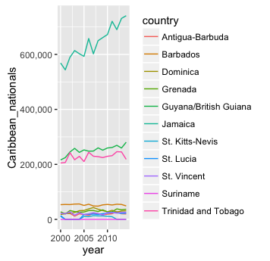
Caribbean Immigrants in the United States

Slide 9
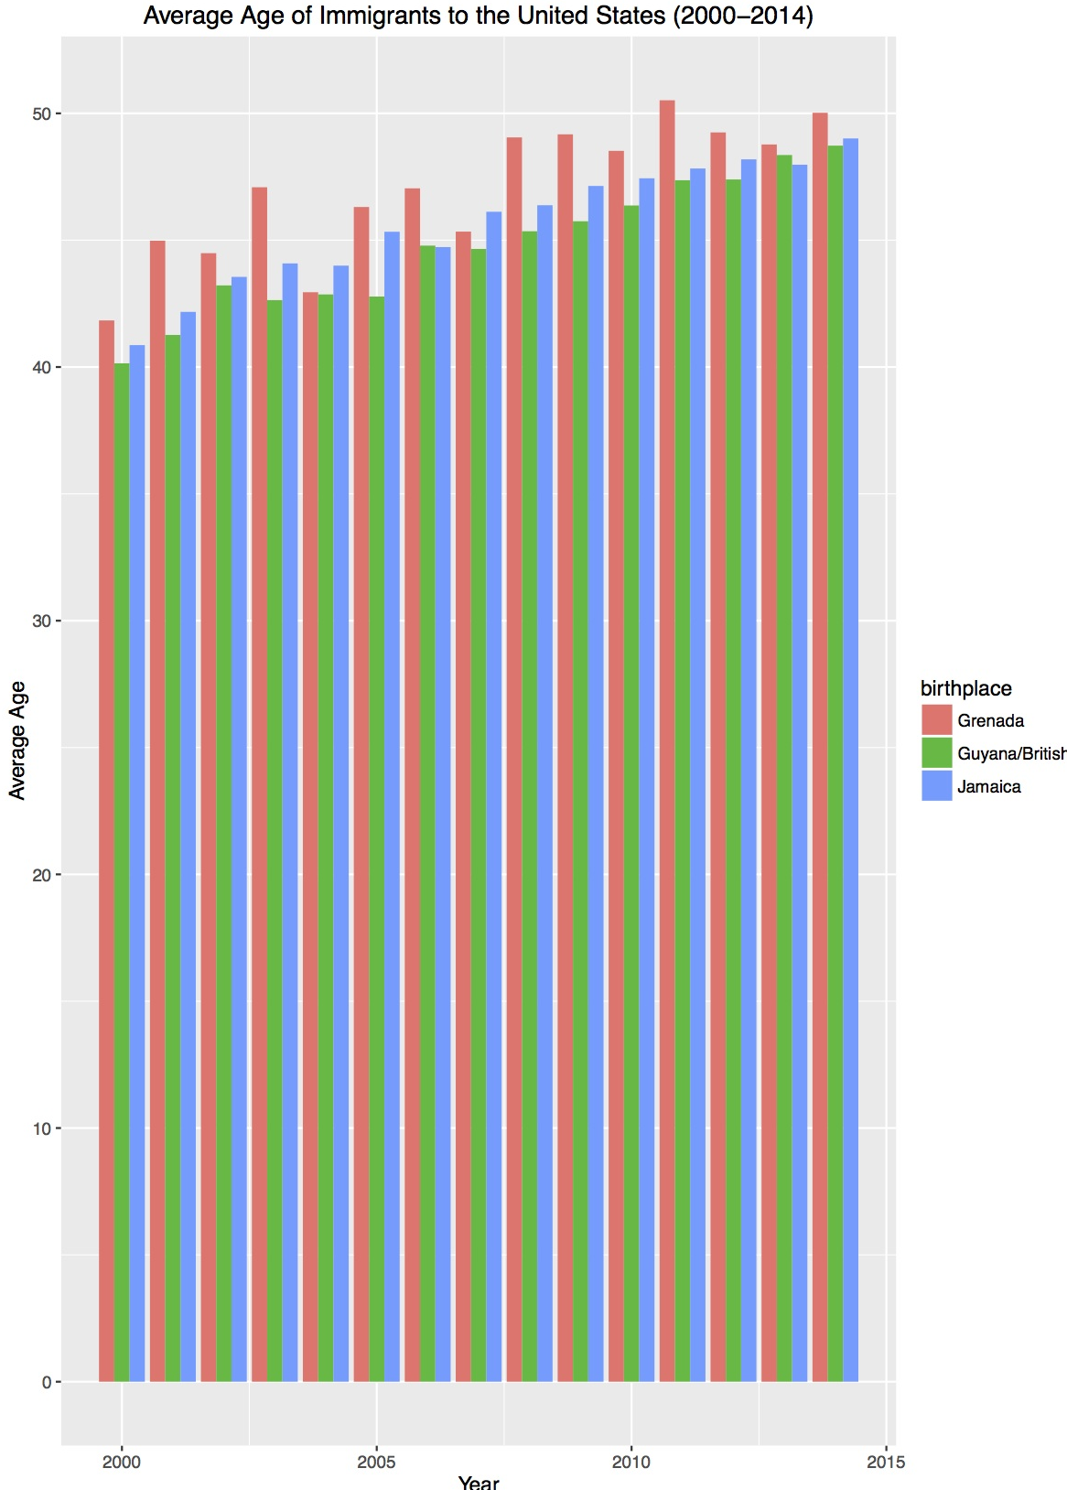
Decomposition of Migrant Population

Slide 10
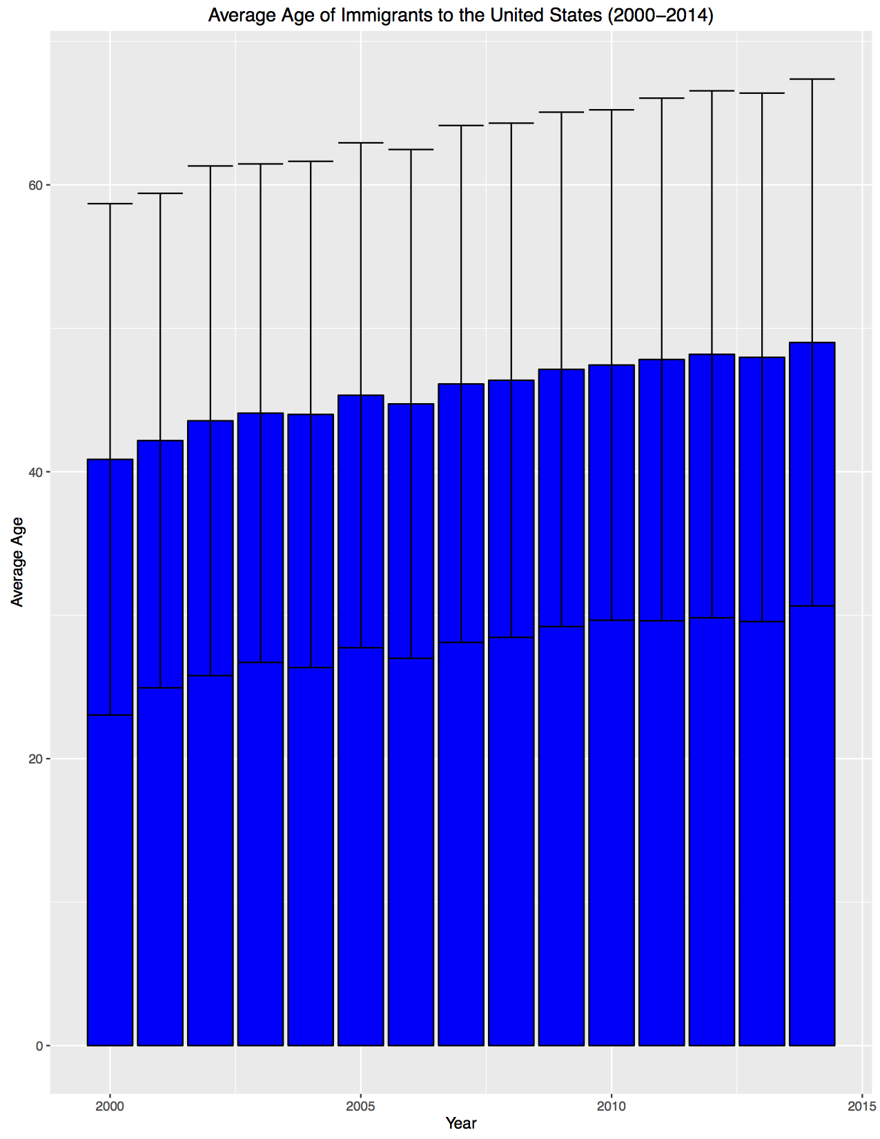

Slide 11
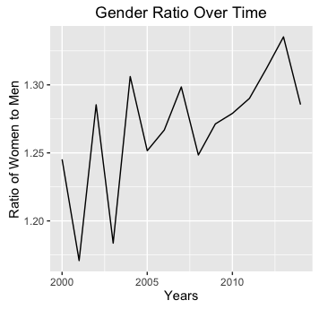

Slide 12
Tertiary Level Education amongst Caribbean born immigrants

Slide 13
Summary Statistics
Variables | mean | SD | median | min | max | range | skew | kurtois | se
PERWT | 109.34 | 123.64 | 75 | 0 | 1902 | 1902 | 3.49 | 18.19 | 0.29
SEX | 1.57 | 0.5 | 2 | 1 | 2 | 1 | -0.27 | -1.93 | 0
AGE | 44.97 | 17.78 | 45 | 0 | 95 | 95 | 0.08 | -0.39 | 0.04
BPL | 267.84 | 15.88 | 260 | 260 | 300 | 40 | 1.53 | 0.34 | 0.04
BPLD | 26824.3 | 1588.05 | 26042 | 26030 | 30040 | 4010 | 1.53 | 0.34 | 3.76
CITIZEN | 2.35 | 0.53 | 2 | 1 | 3 | 2 | 0.1 | -0.94 | 0
YRNATUR | 4857.21 | 3835.99 | 2005 | 1925 | 9999 | 8074 | 0.59 | -1.65 | 13.32
YRIMMIG | 1986.03 | 12.61 | 1987 | 1910 | 2014 | 104 | -0.46 | 0.48 | 0.03
YRSUSA1 | 20.4 | 12.67 | 19 | 0 | 93 | 93 | 0.62 | 0.33 | 0.03
EDUC | 6.42 | 2.61 | 6 | 0 | 11 | 11 | -0.27 | 0.03 | 0.01
OCC | 2454.98 | 2743.59 | 814 | 0 | 9920 | 9920 | 0.94 | -0.12 | 6.5
OCC2010 | 5760.22 | 3108.32 | 5110 | 10 | 9920 | 9910 | 0.05 | -1.18 | 7.37

Slide 14
Econometric Model
OLS Regression
ϒ_{it} = β0_{i} +β₁X₁+ β₂X₂+β₃X₃ … +ε_{i}
Where :
ϒ_{it} – share of immigrant population (Caribbean nationality)
β₁X₁ – time dummy for the year of CSME implementation
β₂X_{2 …} - dummies for each country

Slide 15
ϒ_{it} = β0_{i} +β₁X₁+ β₂X₂+β₃X₃ +β₄X₄ +β₅X₅+β₆X₆ +ε_{i}
Where:
ϒ_{it} – share of immigrant population (Caribbean nationality)
β₁X₁ – educational attainment
β₂X₂ – age
β₃X₃ - sex
β₄X₄ – occupation
β₅X₅ – Immigration status
β₆X₆ - English as a native language

Slide 16
Challenges
The main challenge is finding a model which can answer the question using the available data

